Slide 1
Notes:
Rhona

Slide 2
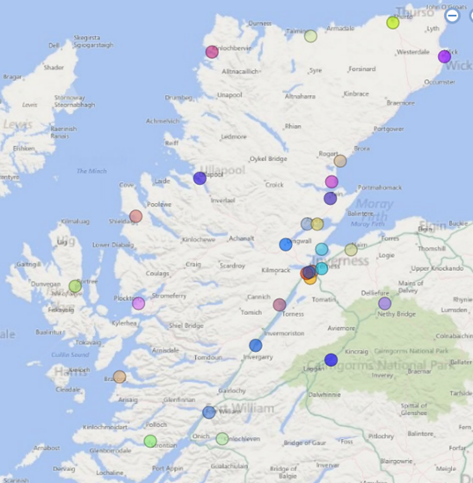
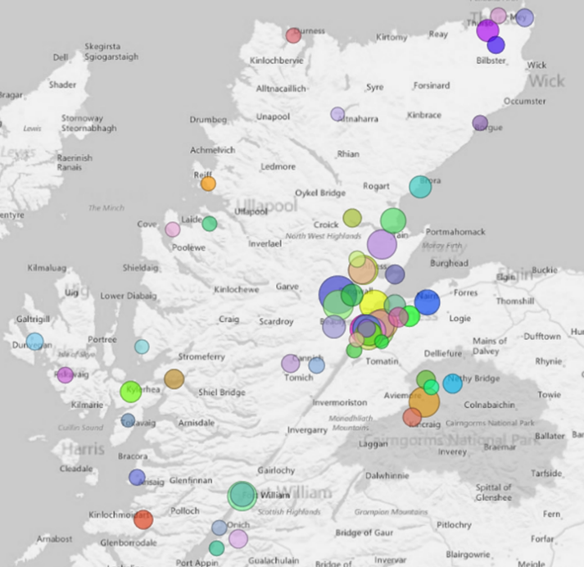
2000 pupils with EAL in schools
20% in nursery
Highland Wide
80+ nationalities
60+ languages
1/3 Polish
Russian, Latvian, Spanish
29 secondary schools
5 special schools
179 primary schools

Slide 3
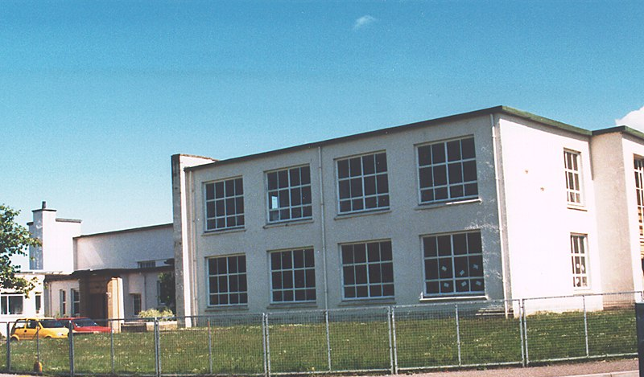
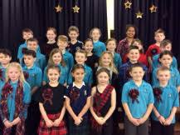
Hilton Primary
47 EAL pupils
12 Languages
Filipino, Greek, Hindi, Kannada, Latvian, Malayalam, Polish, Portuguese, Punjabi, Romanian, Russian, Urdu

Slide 4
Definition of Bilingualism
Bilingual Learners are learners who function in more than one language in their daily lives.
Notes:
Fiona – what is bilingualism…… regardless of level or proficiency ……

Slide 5
The Background and experience of EAL learners
Born in the UK
Completely new arrival to the UK
Family intends to stay in the UK and has the legal right to do so
Status to remain in UK is uncertain or time limited
Orally fluent and fully literate in one or more languages other than English
No literacy in first or other languages
No specific additional support need
Evidence of specific learning difficulties
Stable background – intact family and emotionally secure
Fragmented family background or unaccompanied minor - possible experience of trauma

Slide 6
How many years does it take for an EAL pupil to be fluent at their cognitive level?
What language should parents of EAL pupils use at home with their children – English or their native language?
How many benefits of being bilingual can you think of?

Slide 7
5. Fluent
4. Competent
3. Developing Competence
2. Early Acquisition
1. New to English
5 Stages of English Language Acquisition
Notes:
Rhona

Slide 9
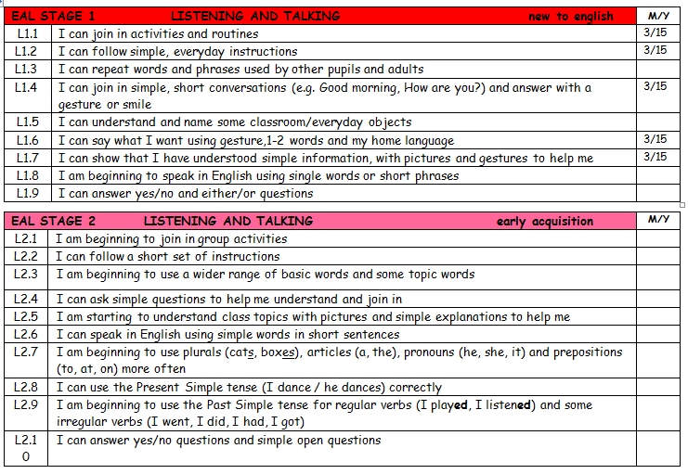

Slide 10
SEEMiS – Edit – ASN/ Language tabs

Slide 11
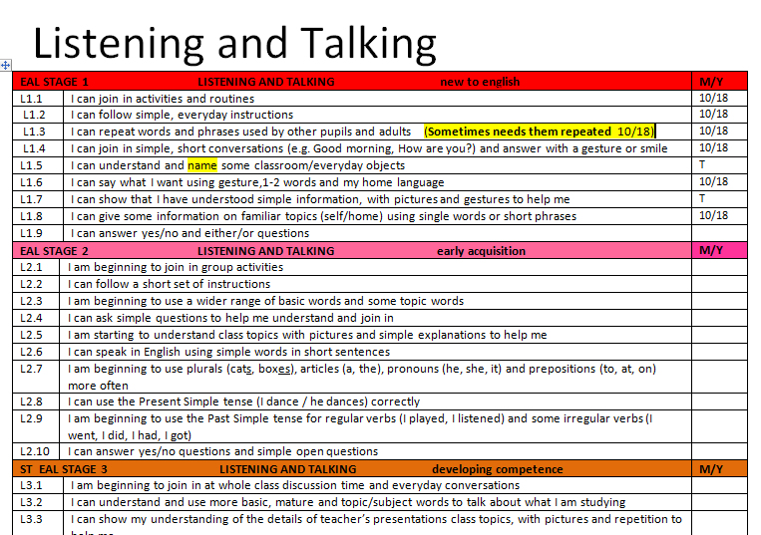
Activity – Listening and Talking
Have a look at the transcripts for pupils A,B, C and D.
What Listening and Talking Level/Levels do you think each pupil is working at?

Slide 12
Writing Samples Activity
Look at the sample of writing.
Which level (in writing) do you think he is working at?
Notes:
Give out samples of writing.
Can they identify what level in writing these pupils are working at?
Give out case studies. Can they match the samples to the case studies?
Choose I pupil (per group). Note strategies that could be used to support them with a writing task.
Do the same for another pupil (if time.) Feed back to the whole group (if larger numbers)

Slide 16
New to English EAL Language Programmes

Slide 17
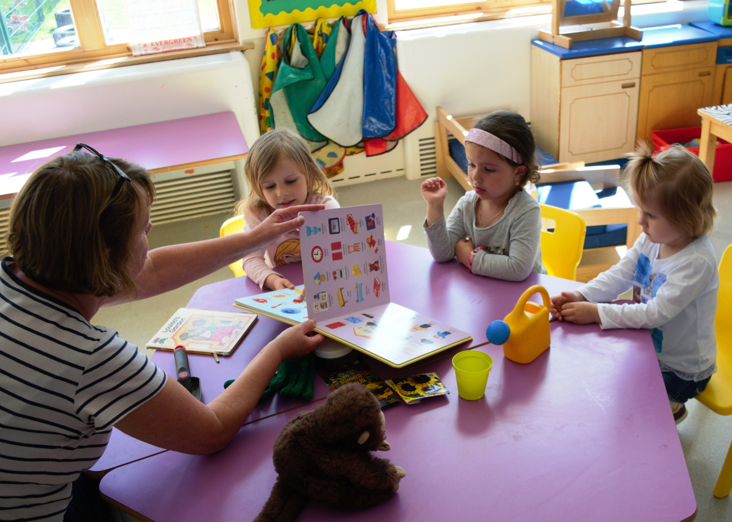
Teddy Talk
Nursery

Slide 18
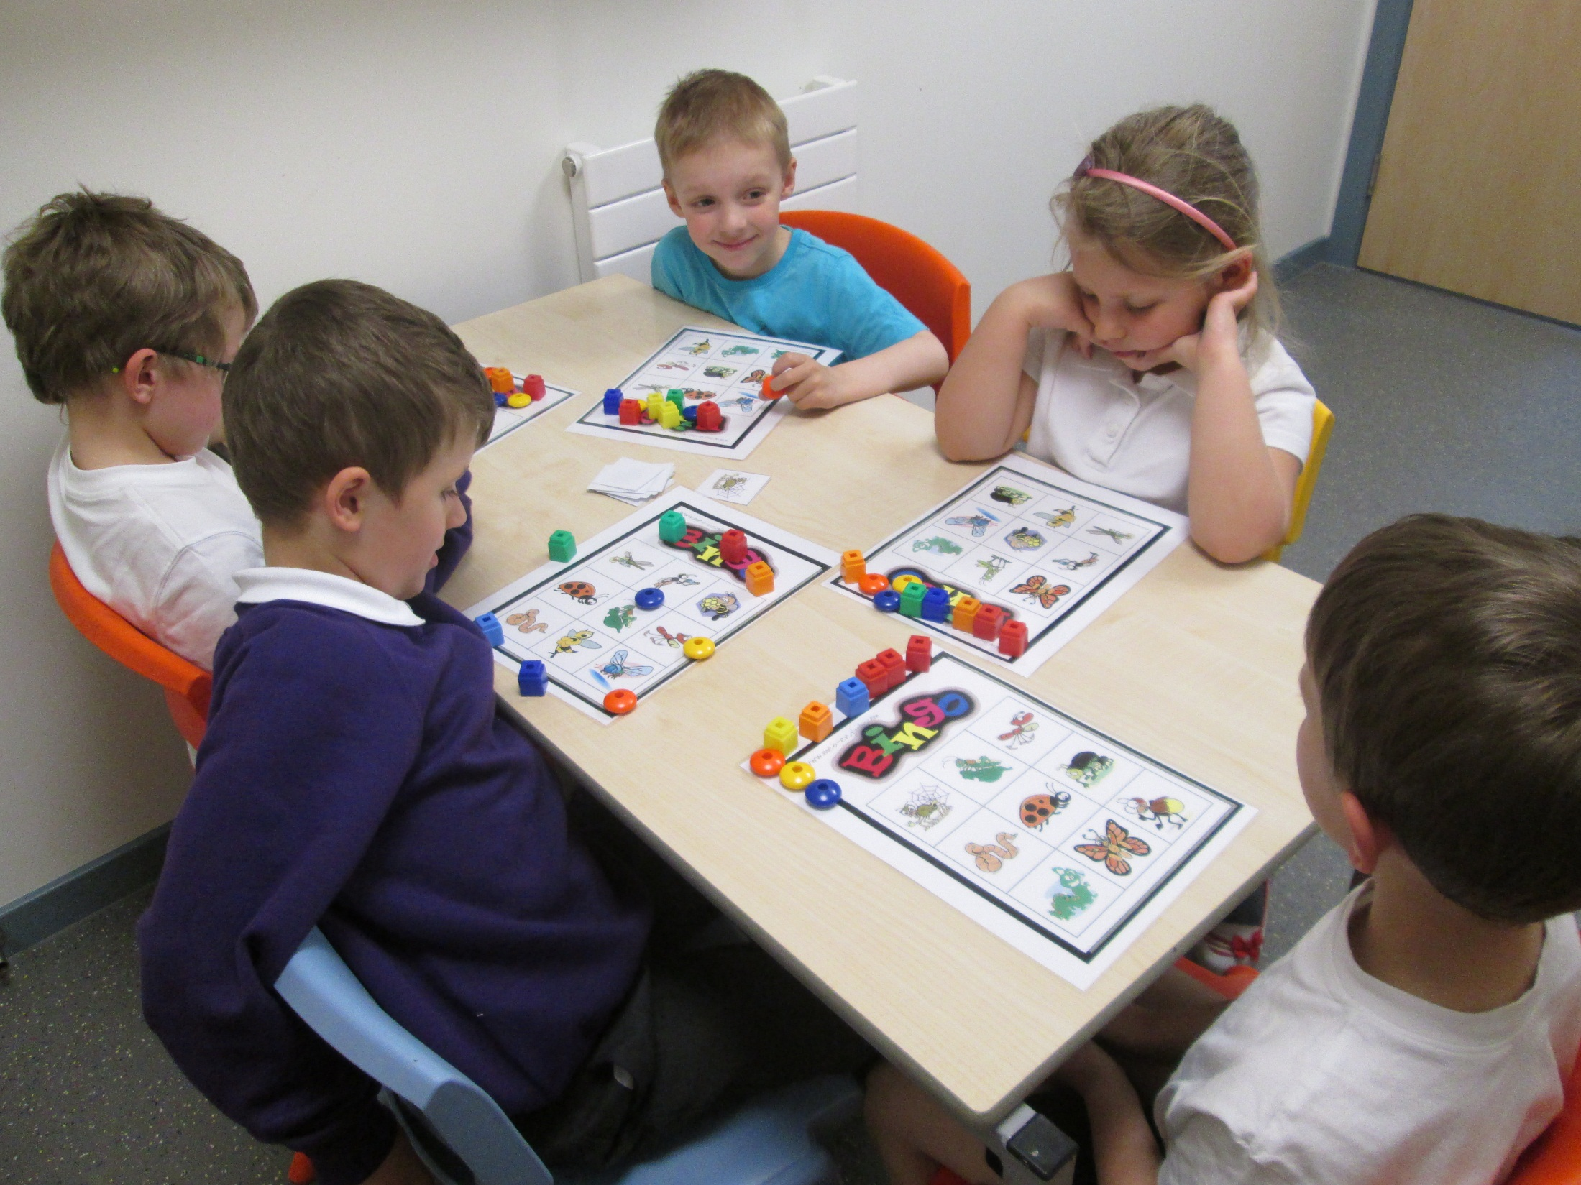
Big Bear Banter
P1-3

Slide 19
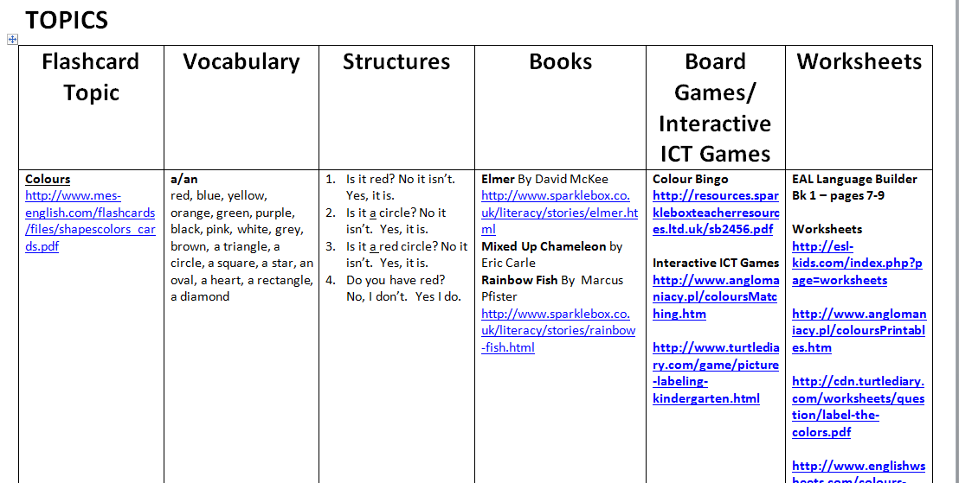
P4-7
EAL Induction Pack

Slide 20
Home Language/ Mother Tongue/ First Language/ Native Language

Slide 21
Why is it important for a child to maintain their home language?
What can school do to support and value home languages?
First languages help families share values, traditions and cultural identities.
Children who can speak another language can also learn English better because they see when words are similar (or have a similar meaning).
Speaking more than one language improves thinking skills, memory and brain health
Employers value people who are good at languages so there will be more job opportunities
Learn the names of the languages children speak and teach them the name in English/ their home language
Use home languages for learning and teaching
Make links to cultural heritage e.g. through projects etc.
Multicultural ethos is reflected throughout the school e.g. signage, displays
Students as young interpreters
Sharing stories in different languages
Try to learn a few words from languages spoken in the school
http://www.newburyparkschool.net/langofmonth/index.html

Slide 22
Around the World in a Week
Language Awareness Project between Adult ESOL Learners and Schools

Slide 23
ealhighland.org.uk

